Slide 1
LESSON 3.2c
Complex Solutions and Zeros

Slide 2
Where are we? What are we doing? Where are we going?
Learning how to “solve” quadratic functions/equations
… find the “roots” of the function/equation … which are the same as the x-intercepts.
Solve by graphing the equation on your graphing calculator (yesterday)
Solve Algebraically
using square roots (L3.1 yesterday)
by factoring / “finding the zeros” of the function (L3.1 today)
when the quadratic has COMPLEX SOLUTIONS
completing the square (L3.3)
using the quadratic function (L3.4)

Slide 3
Today you will:
Solve quadratic functions with complex solutions
Practice using English to describe math processes and equations

Slide 4
So far…
We’ve said when asked to solve something like the following the answer is no solution:
$x^{2}=−4$
Actually the correct answer is:
No solution IN THE REAL NUMBER SYSTEM
But what if we considered the complex number system? Would we be able to get an answer then?

Slide 5
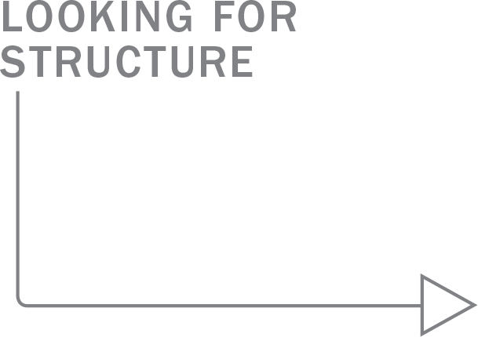
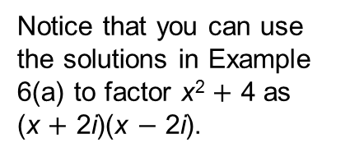
Solve (a) x² $+$ 4 $=$ 0 and (b) 2x² $−$ 11 $= −$47.
SOLUTION
a. x² $+$ 4 $=$ 0
Write original equation.
x² $=$ $−$4
Subtract 4 from each side.
Notice that you can use
the solutions in Example
6(a) to factor x² $+$ 4 as
(x $+$ 2i)(x $−$ 2i).
x $=$ $±\sqrt{−\text{4}}$
Take square root of each side.
x $=$ $±$2i
Write in terms of i.
The solutions are 2i and $−$2i.
b. 2x² − 11 $=$ $−$47
Write original equation.
2x² $=$ $−$36
Add 11 to each side.
x² $=$ $−\text{1}\text{8}$
Divide each side by 2.
x $=$ $±\sqrt{−\text{18}}$
Take square root of each side.
x $=$ $±\text{i}\sqrt{\text{18}}$
Write in terms of i.
x $=$ $±\text{3}\text{i}\sqrt{\text{2}}$
Simplify radical.
The solutions are 3i$\sqrt{\text{2}}$and $−$3i$\sqrt{\text{2}}$.

Slide 6
Work on #49-50 page 109 in your text.
You have 10 minutes.

Slide 7
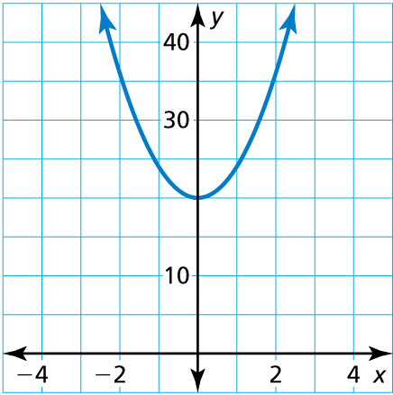
Find the zeros of f(x) $=$ 4x² $+$ 20.
SOLUTION
The graph of f does not
intersect the x-axis, which means f has no real zeros. So, f must have complex zeros, which you can find algebraically.
4x² $+$ 20 $=$ 0
Set f(x) equal to 0.
4x² $=$ $−$20
Subtract 20 from each side.
x² $=$ $−\text{5}$
Divide each side by 4.
x $=$ $±\sqrt{−\text{5}}$
Take square root of each side.
x $=$ $±\text{i}\sqrt{\text{5}}$
Write in terms of i.
So, the zeros of f are i$\sqrt{\text{5}}$and $−$i$\sqrt{\text{5}}$ .
Check
✓
f (i$\sqrt{\text{5}}$) $=$ 4 (i$\sqrt{\text{5}}$)² $+$ 20 $=$ 4 $•$ 5i ² $+$ 20 $=$ 4($−$5) $+$ 20 $=$ 0
✓
f ($−$i$\sqrt{\text{5}}$) $=$ 4 ($−$i$\sqrt{\text{5}}$)² $+$ 20 $=$ 4 $•$ 5i ² $+$ 20 $=$ 4($−$5) $+$ 20 $=$ 0

Slide 8
Work on #55-62 page 109 in your text.
You have 10 minutes.

Slide 9
Homework
Pg 109, # 49-61, 63-65, 67-68, 71-74

